Slide 1
Can dynamic byte-level patches outperform fixed tokens as the basic unit for scaling LMs?
Gus Fridell, Ernie Chu, Alex Martin, Austen Liao, Kuleen Sasse

Slide 2
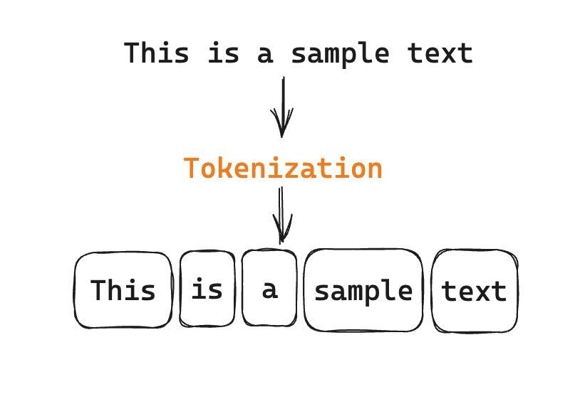
Tokenization Intro
Tokenization is how we discretize language input and prepare it for model evaluation
Notes:
tokenization is how our field has decided to reliably discretize text so that it can be processed efficiently by language models

Slide 3
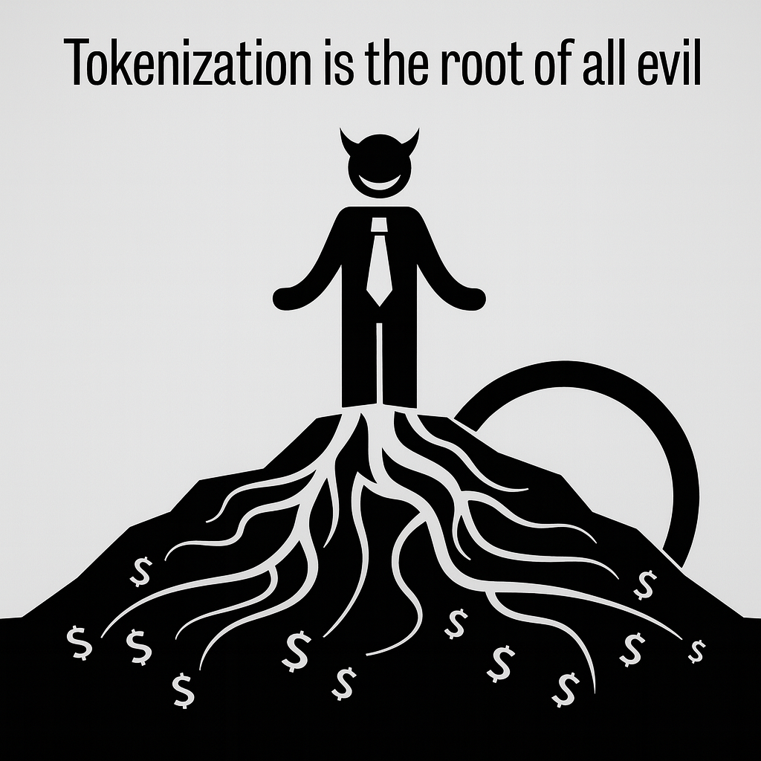
my grandmother used to tell me:
Biased
Heuristic preprocessing step
Leads to input sensitivity
Lack of spelling knowledge
Domain/modality sensitivity
Multilingual inequity
Static amount of compute per token
…
Notes:
my grandmother used to tell me
our token vocabulary is heuristically defined in a preprocessing step that is separate from the training of the model, which has certain implications
can incur bias which results in sensitivity problems
input sensitivity - from spelling errors, typos, and other perturbations, how a piece of text would be tokenized can change drastically
domain - tokenization is likely only optimal for domains similar to those that the tokenization is learned from
tokenization learned from natural language, is the tokenization scheme gonna be good for code?
this doesn’t generalize to different languages

Slide 4
Does tokenization belie the “spirit” of deep learning?
End-to-end learning philosophy: learn hierarchical representations from raw data
Tokenization is a fixed processing step between raw text and the model
static, context-independent boundaries
”The Bitter Lesson”
"The biggest lesson that can be read from 70 years of AI research is that general methods that leverage computation are ultimately the most effective, and by a large margin."
Notes:
the end-to-end deep learning philosophy is that all of our representations should be learned from the data
We’ve effectively split the learning process, we’ve separated tokenization from the rest of the computation that is learned by the model
Replacing tokenization involves incorporating the data chunking directly into the model
bitter lesson is that our representations should be learned by the model instead of determining them by hand

Slide 5
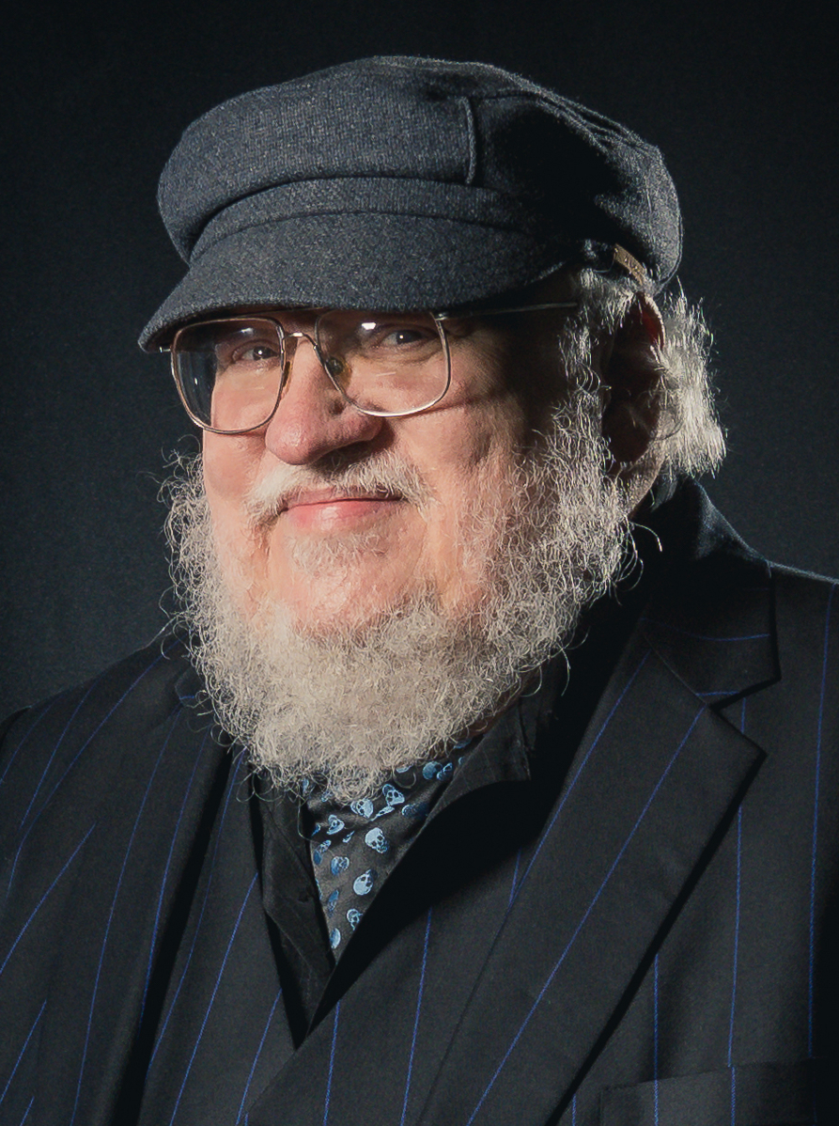
Methods of Tokenization
Daenerys Targaryen is in Game of Thrones, a fantasy epic by George R.R. Martin

Slide 6


Methods of Tokenization
Daenerys Targaryen is in Game of Thrones, a fantasy epic by George R.R. Martin

Slide 7
Methods of Tokenization: Characters
Daenerys Targaryen is in Game of Thrones, a fantasy epic by George R.R. Martin
D, a, e, n, e, r, y, s, ‘’, T, a, r, g, a, r, y, e, n… (I got tired)
Notes:
character level
every member of our sequence is a character
think of maintaining a table mapping individual characters to embedding vectors
pros - rich signal from representing every char
cons - long sequence is expensive (we know that attention computation grows quadratically with sequence length), deal with issues surrounding context length

Slide 8
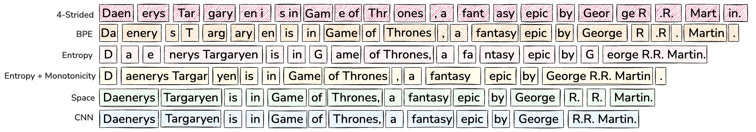
Methods of Tokenization: BPE
Daenerys Targaryen is in Game of Thrones, a fantasy epic by George R.R. Martin
D, a, e, n, e, r, y, s, ‘’, T, a, r, g, a, r, y, e, n… (Character level)
Subword merge
Notes:
building off of character-level symbols
we start with that and recursively merge symbols that commonly appear next to each other, ending with additional larger symbols
common practice today

Slide 9
Methods of Tokenization: Strides (4)
Daenerys Targaryen is in Game of Thrones, a fantasy epic by George R.R. Martin
Notes:
set fixed size for each chunk
depending on what we set a stride hyperparameter, chunks can be designed to overlap as well

Slide 10
Methods of Tokenization: Space
Daenerys Targaryen is in Game of Thrones, a fantasy epic by George R.R. Martin
Notes:
dividing by space - effectively word-level tokenization
noteworthy is that the more you prioritize large tokens, the higher chance that you encounter a word at test-time that cannot be constructed by the tokens that you retain, at least not in a way that you’ve been trained on them.

Slide 11
Methods of Tokenization: Tradeoff
smaller tokens: richer representation but longer sequences (and vice versa)
different tokenization schemes suited for different sequencing tasks
character-level
tokenization
sentence-level tokenization
genome sequencing models
traditional LLMs
large concept models
Notes:
tradeoff of
smaller tokens resulting in richer representations but longer sequences (more computational costs, more context length constraints)
larger tokens result in coarser representations but more efficient computation and less restrictive context length constraints
there are different places that are appropriate to use both
genome sequencing - any individual character can be biologically critical if perturbed, so representing each character with its own token is important
FAIR has research in large concept models, which embeds entire sentences as sequence items with the goal of operating at the level of concepts, or “higher-level semantic representations”

Slide 12
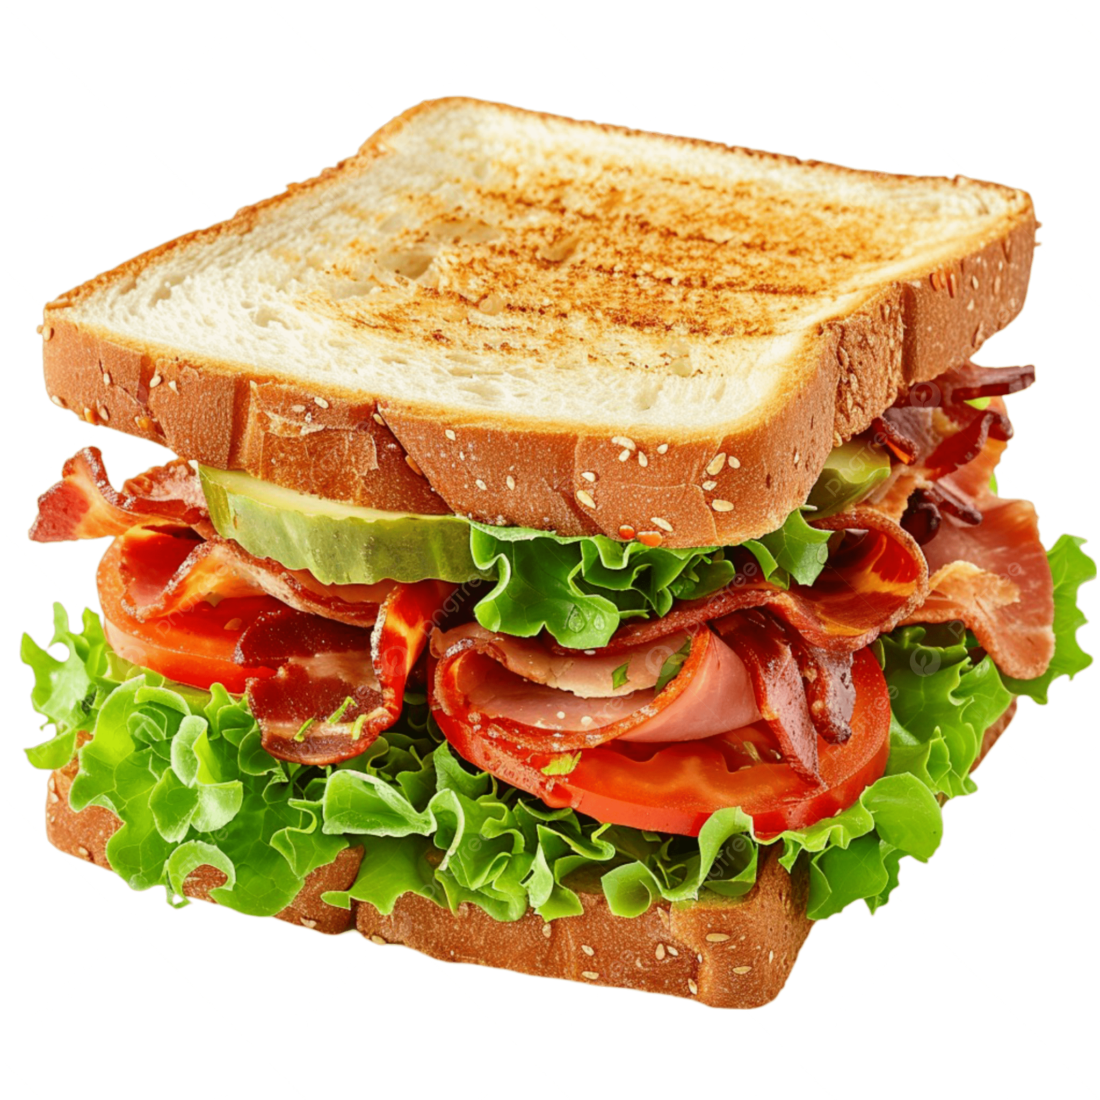
Byte Latent Transformer
Artidoro Pagnoni, Ram Pasunuru, Pedro Rodriguez, John Nguyen, et al.

Slide 13
Motivation
Notes:
Tokenization is big issue!
Heuristic preprocessing step
Bias in the model architecture
Domain/modality sensitivity
Sensitivity to input noise
Multilingual equity
Lack of orthographic knowledge (spelling)

Slide 14
Motivation
Biased
Heuristic preprocessing step
Leads to input sensitivity
Lack of spelling knowledge
Domain/modality sensitivity
Multilingual inequity
Static amount of compute per token
…

Slide 15
Motivation
Can we match tokenizers without using tokenization at all?

Slide 16
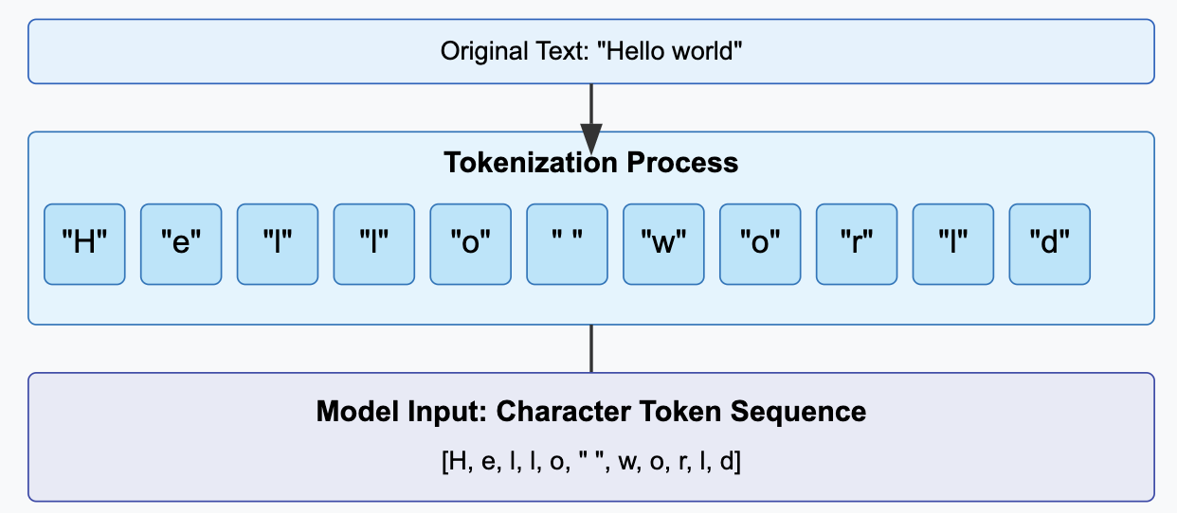
Background: Character Transformers
Based on representing text as a sequence of individual characters
Pros:
Flexible (no OOV)
Dealing with morphologically rich languages
Robust to noise
Small vocabulary
Cons:
Creates long sequence lengths
More expensive to train

Slide 17
Patching
The way the model dynamically groups the bytes into chunks (without vocab)
Allows BLT to dynamically allocate compute based on context
Many different methods:

Slide 18
Patching
The way the model dynamically groups the bytes into chunks (without vocab)
Allows BLT to dynamically allocate compute based on context
Many different methods:

Slide 19
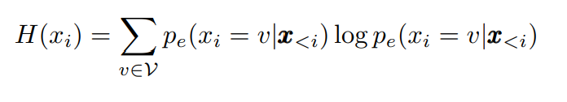
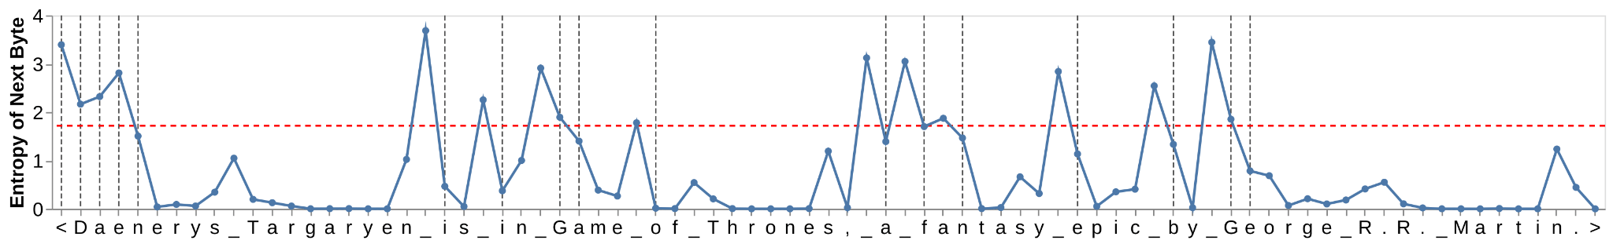
Entropy Patching
Data driven approach
Small auto-regressive LM to compute next byte entropies
Splitting:
Threshold: H(x_t) > T
Difference Threshold: H(x_t) - H(x_{t-1}) > T

Slide 20
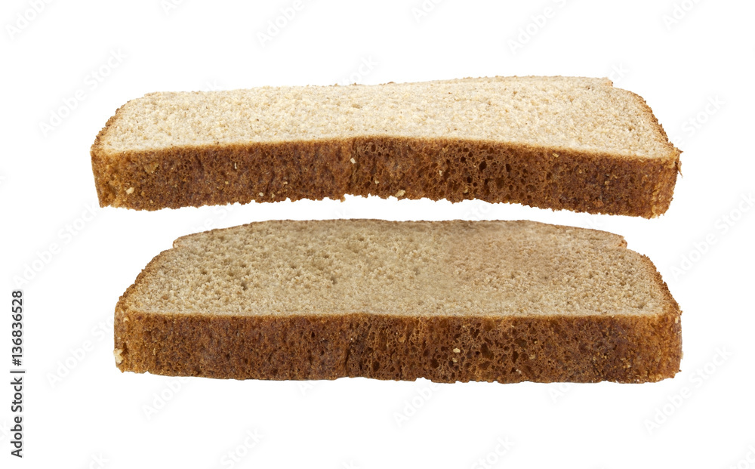
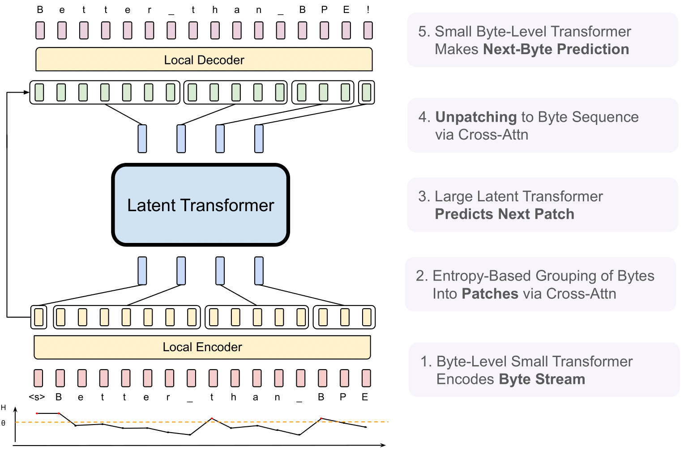
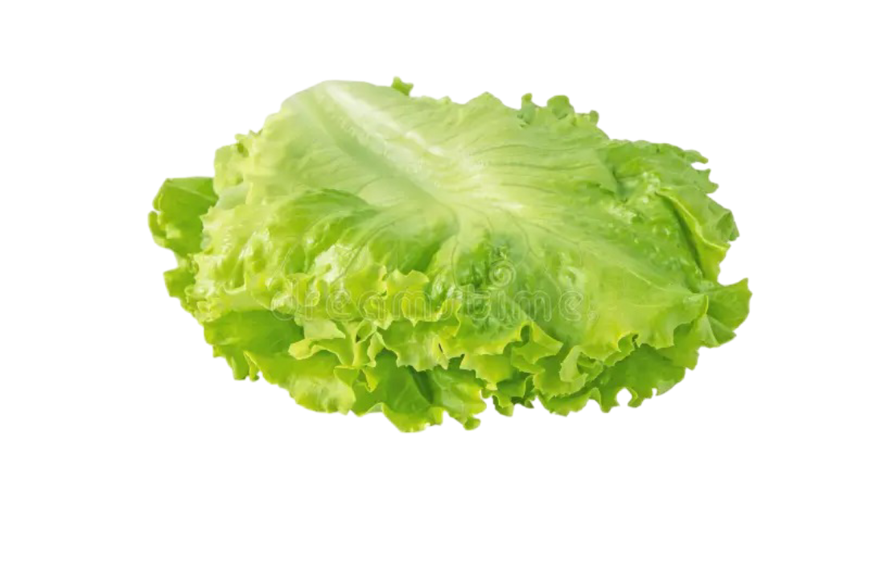
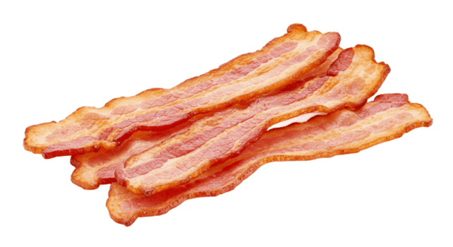

BLT Architecture

Slide 21
BLT: Latent Global Transformer
Large autoregressive model
Same as a regular LLM
Maps sequence of patch inputs p_j to output representations o_j

Slide 22
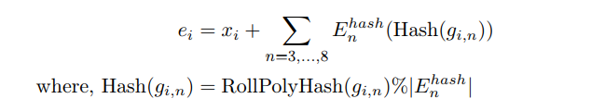
BLT: Generating Local Encoder Embeddings from Bytes
Start with individual byte embeddings (x_i).
Extract byte n-grams (lengths 3 to 8) for context.
Map n-grams using RollPolyHash (allows collisions).
Sum the byte embedding (x_i) and its hashed n-gram embeddings.

Slide 23
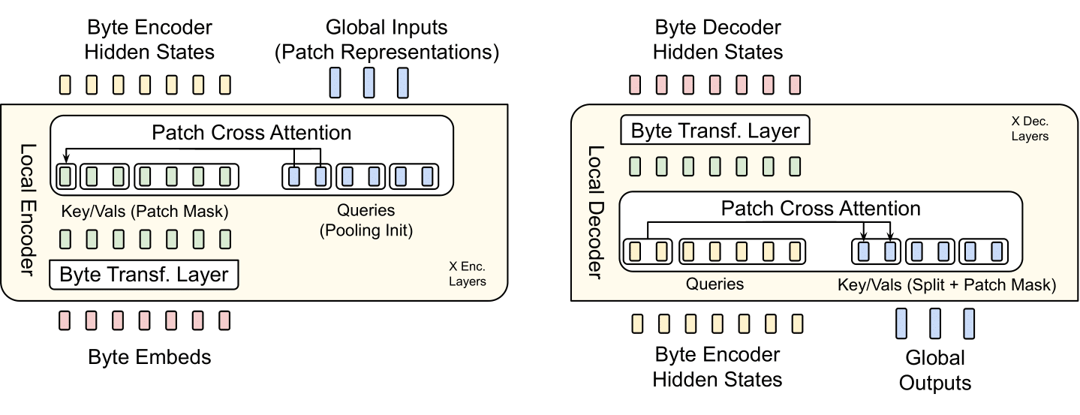
BLT: Local Encoder Model
Goal: Use byte embeddings add expressive information to patch embeddings using a small transformer.
Each patch starts with a query vector created by max pooling its bytes and a linear layer
A small transformer produces contextual byte representations with local attention
Patch queries attend only to the bytes inside their patch (patch mask).
Alternating cross-attention and local attention layers adds local information to patch representation

Slide 24
BLT: Local Decoder
Goal: Use global patch representations after latent global transformer to update byte-level states from encoder.
Patches now inform bytes instead of the other way around
Cross-Attention: Each byte attends only to its patch’s global representation
Updates bytes local information with global context.
Still updates the byte with local information after the cross attention

Slide 25
Experimental Setup
Pre-training datasets
Llama 2 dataset (2 trillion tokens) - used for architectural choices/scaling laws
BLT 1T (public data + DataCompLM) - used to compare to LLaMa 3
Entropy model
LM trained on same training distribution
100M parameters with sliding window of 512 bytes
Entropy Threshold: Choose threshold that achieves average patch size on pretraining mix

Slide 26
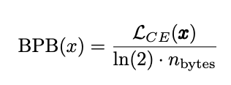
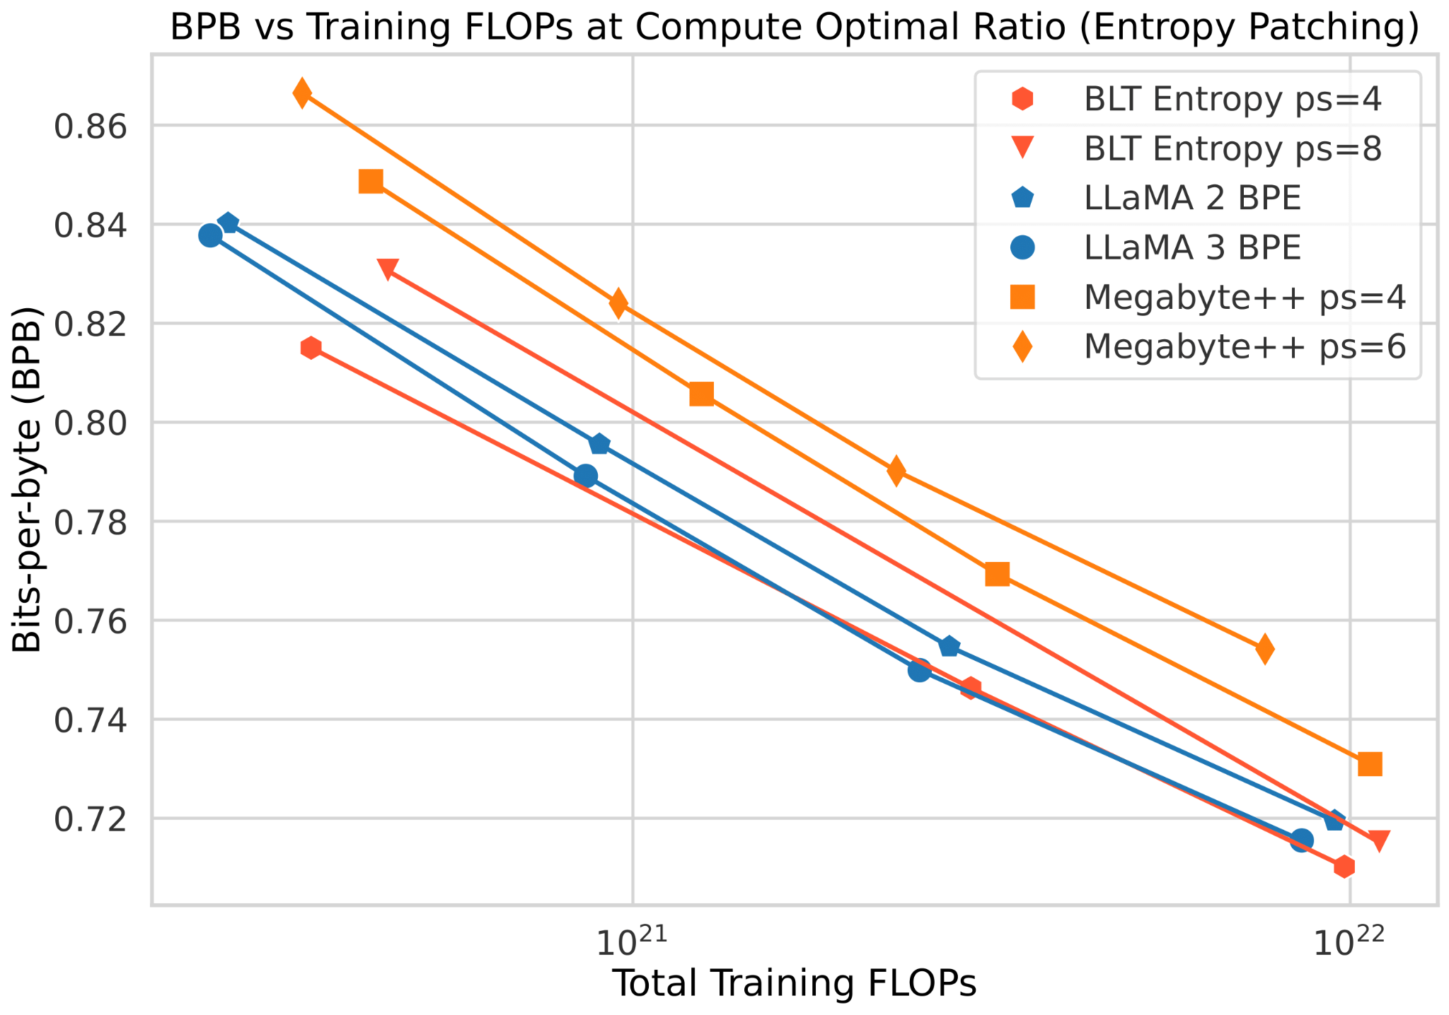
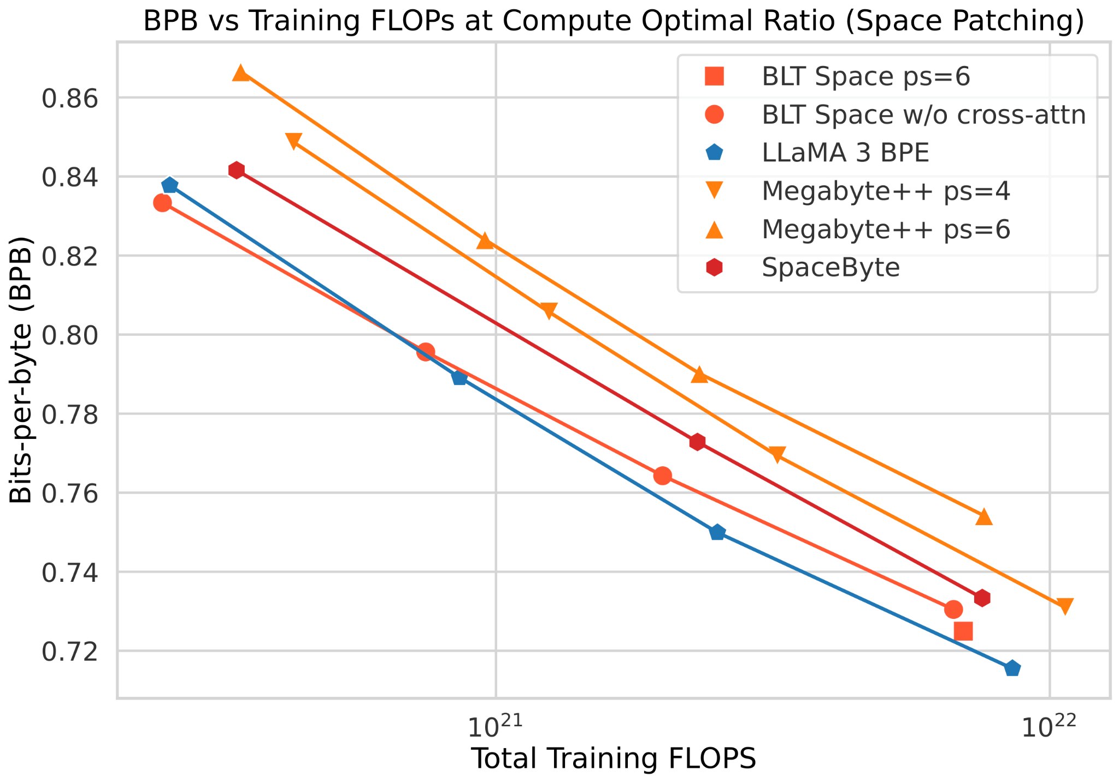
Scaling Trends
BPB = Tokenizer independent perplexity
Notes:
Bits per Bytes
Perplexity only makes sense for fixed tokenizer
Tokenizer independent version of perplexity
Calculated as Cross Entropy Loss of X divided by ln(2) times number of bytes in X
the uncertainty over the data x as measured by the sum of the cross-entropy loss is normalized by the total number of bytes in x and a constant.

Slide 27
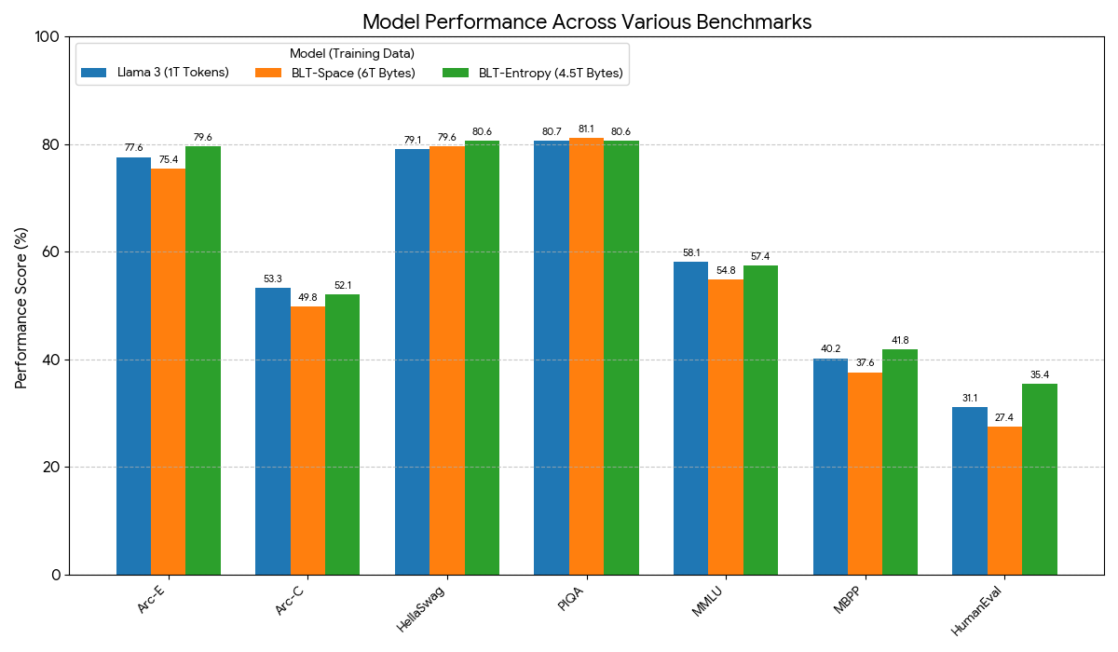
Performance
Notes:
8B BLT model beyond the compute optimal ratio on the BLT-1T dataset

Slide 28
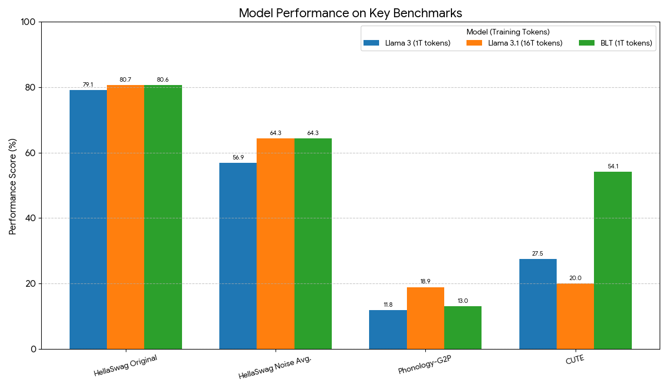
Improves Robustness
Notes:
8B BLT model to 8B BPE Llama 3

Slide 29
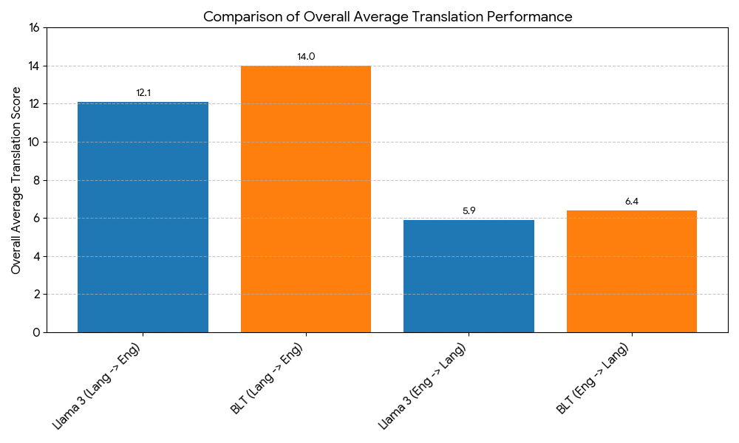
Low Resource Machine Translation
Notes:
8B BLT and 8B Llama 3 trained for 1T tokens on translating into and from six widely-used languages and twenty one lower resource languages with various scripts from the FLORES-101

Slide 30
Limitations
The entropy threshold
Passed the buck down to the human at inference time
Can we have a no hyperparameter method?
The entropy patch model
Seems like the tokenizer bias lies in the model
Can we have this be learned end to end?
The local encoder and decoder model architectures
Are these truly optimal?
How did they choose them?

Slide 31
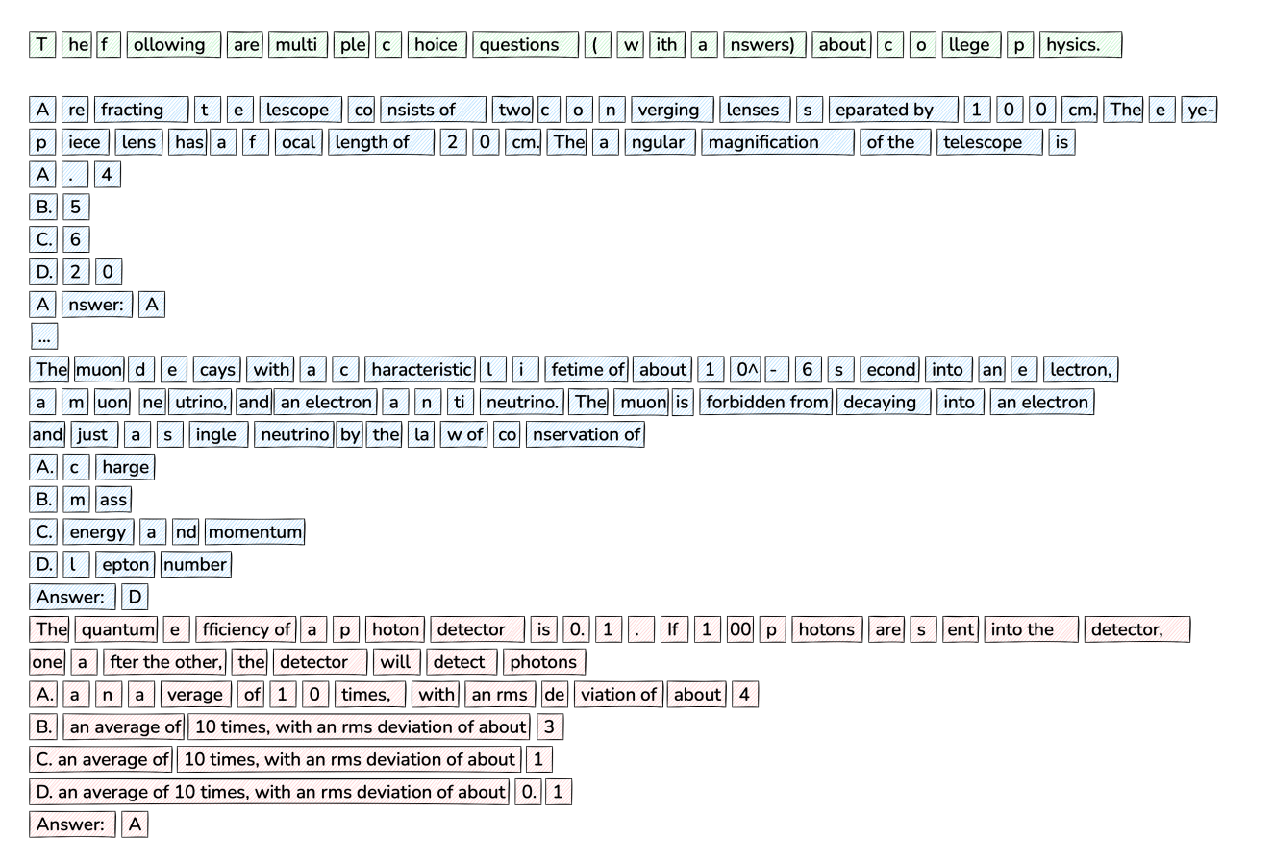

Slide 32
Questions
Does this actually prove that tokenization is the root of all evil? Are we barking up the wrong tree in trying to keep text as the input?
Could these insights of dynamic allocation be brought to other long context tasks or other modalities?
Will these models suffer the same or worse fate as transformers in the long context regime?
Will these models scale to the 10s of billions?

Slide 33
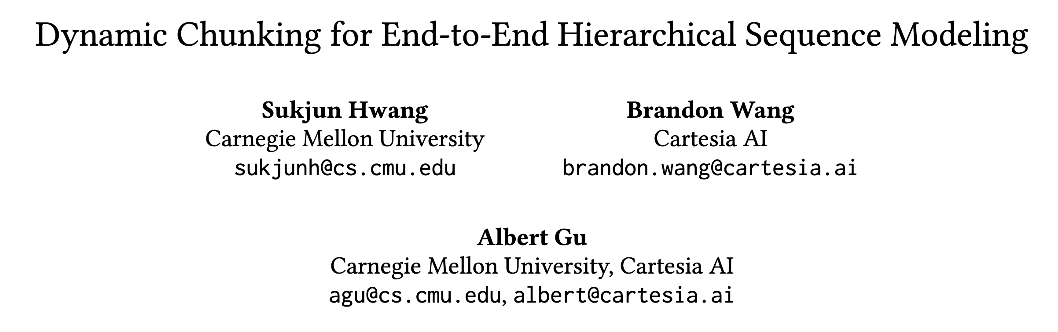

Slide 34
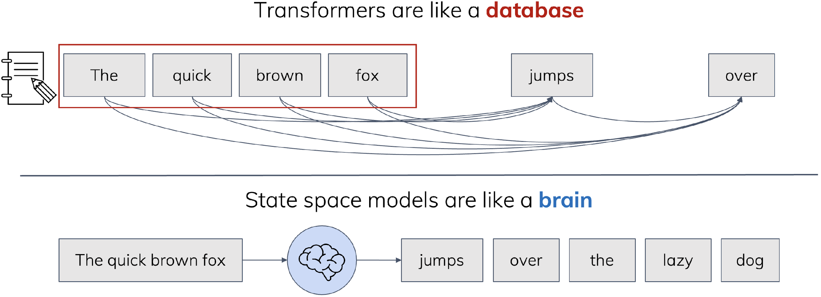
Aside: Mamba (SSM)
Intuitive blog by Mamba’s Author (Albert Gu): https://goombalab.github.io/blog/2025/tradeoffs/
Notes:
Mamba: linear, Transformer: quadratic
Transformer: works well when tokenized (semantic embeddings)
Even with more compute, transformer cannot catch up with mamba when directly modeling bytes. We’ll see in next slide
"While Transformers naturally store complete key-value caches for all positions, SSMs are designed to compress information into fixed-size states. This compression-oriented architecture aligns naturally with our chunking mechanism."

Slide 35
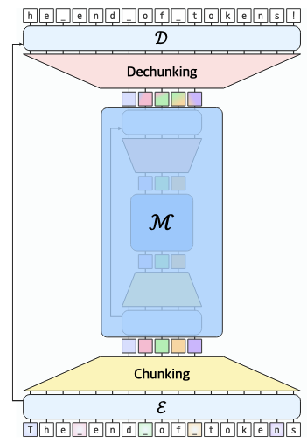

H-Net: Hierarchical Processing
H-Net
U-Net
Notes:
Architecturally, these networks are the same, they both use the U-net structure of Encode 🡪 downsample 🡪 transform 🡪 upsample 🡪 decode
Because the H-net is end-to-end, it can be iterated on recursively: the “main” network can itself be an H-net
More stages of chunking represent higher order meanings

Slide 36
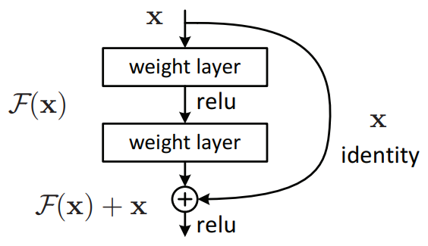
Residual Connections
Popularized by ResNet in 2015
Understood as a solution to vanishing gradients
Optimization “highways”
Ensemble of many shallow networks
Feature reuse
Early layers’ features can be accessed by deeper layers

Slide 37
Architectural Overview
H-Net progressively compresses
s = stage index (0 at byte level, S at innermost)
Encode: E^s processes input x^s → output x̂^s
Chunk: compress x̂^s →x^(s+1) + p^s
Shorter sequences + boundary probabilities
Main network M processes x^S
ẑ^S = M (𝑥^S )
Dechunk: expand ẑ^s back to original resolution using p^s
Decode: D^s produces final output
Notes:
Raw bytes 🡪 encoder^0 --> chunking 🡪 Main 🡪 dechunking 🡪 decoder^0 🡪 output bytes
X^0 🡪 x_hat^0 🡪 x ^ 1 🡪 Z_hat^1 🡪 z^0 🡪 output

Slide 38
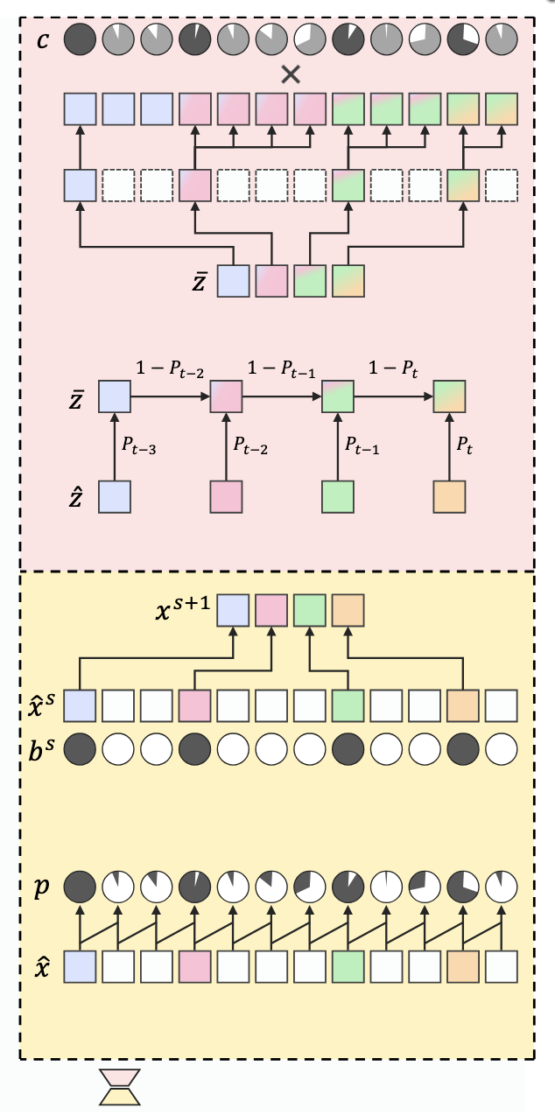
Dynamic Chunking (DC) Overview
Routing module (bottom): predicts boundaries between adjacent elements through a similarity score
Chunk boundaries are drawn
Downsampler selectively retains semantically significant positions
Dechunking
Smoothing module: discrete → interpolated representation
Upsampler

Slide 39
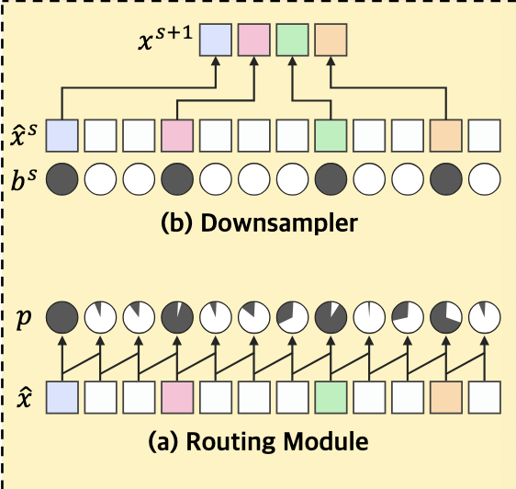
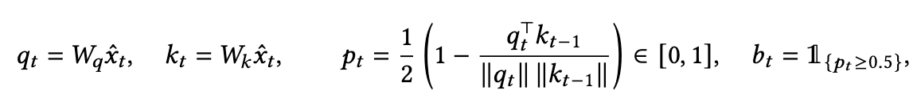
Chunking: Router Module + Downsampling
Detects semantic shifts by measuring similarity between adjacent positions
High similarity between consecutive positions → low p_t (no boundary)
Low similarity between consecutive positions → high p_t (likely boundary)
Projections W_q and W_k are learned matrices that project encoder outputs into query/key spaces
Cosine similarity between current and previous positions
Direct selection: only keep vectors b_t = 1
Notes:
Cosine = 1 (identical) → p_t = 0 (no boundary)
Cosine = -1 (opposite) → p_t = 1 (strong boundary)
Cosine = 0 (orthogonal) → p_t = 0.5 (uncertain)
P_t only depends on current q_t and previous k_{t-1} positions
semantic transitions often correspond to representation direction
Uses simplest possible compression ; Authors say they tested mean/max pooling/cross attention, but found direct selectino works as well

Slide 40
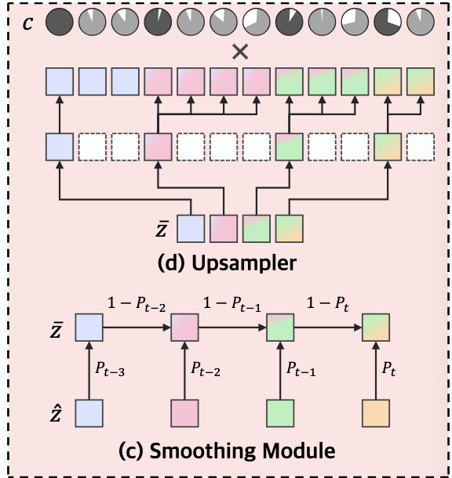
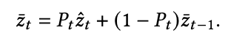
Dechunking: Smoothing
Chunk boundaries are discrete by nature, which impedes gradient flow
High confidence → use current chunk
Low confidence → blend with previous using Exp. Moving Avg
Notes:
Input: ẑ_t are the compressed chunk representations from main network
Weights: P_t are the boundary probabilities (same as from chunking)
Recursion: Each position depends on current chunk + smoothed previous positions
Creates continuous gradients thru boundary decisions

Slide 41
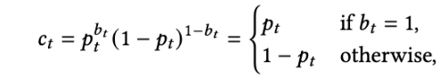
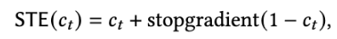
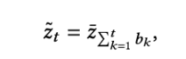
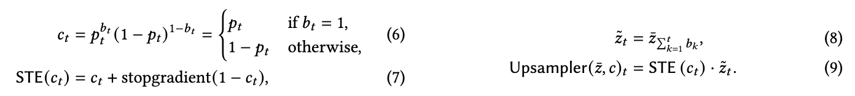
Dechunking: Upsampler
Step 1: confidence scoring
Set c_t to p_t if b_t = 1
b_t = 0 → c_t = 1-p_t
Step 2: gradient stabilization
”Straight Through Estimator” (STE) rounds confidence to 1 in fwd pass
Backward pass preserves gradients: ∇STE(c_t) = ∇c_t
Step 3: causal expansion
Each position gets information from most recent chunk
Boundaries z̃ : [1, 0, 0, 1, 0, 1] Chunk indices z̄ : [1, 1, 1, 2, 2, 3]
Step 4: Confidence-weighted output
Notes:
If b_t = 1, high conf boundary is rewarded, same with low confidence boundary scoring
Gradient stabilization trick: if the authors just used partial weighting then passing low confidence forward through the model could create instability in the form of weak signal
Keeping the ”real” confidence in the backward pass preserves learning information
Rounding confidence to 1 in the forward pass while still maintaining continuous gradients during backpropagation

Slide 42
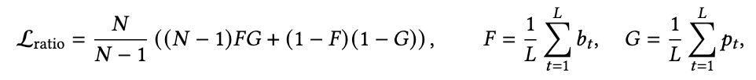
Ratio Loss: how to prevent trivial chunking strategies
Degenerate strategies are learned without guidance
Ratio loss:
F represents fraction of positions selected as boundaries
G is average boundary probability
N is target compression ratio
Loss minimized when F = G = 1/N
Ratio Loss helps balanced utilization, creates pressure for more confident boundary decisions
Notes:
100% of positions are boundaries, 0% are boundaries
F: discrete boundary decisions
G: continuous probabilities
N: what we want to do
F=G matches reality, = 1/N matches target ratio
when the model selects too many boundaries, over-compressed regime, L_ratio > 1 Borrowed from mixture of experts load balancing: some experts get overused, others ignored. In H-Net some positions get selected, others ignored, ratio loss helps with balanced utilization

Slide 43
Training Practices for Hierarchical Sequence Modeling
RMSNorm
Pre-normalization residual flow:
X → LayerNorm → Attention → X + F(X)
H-Net uses RMSNorm at the end of each network, so that contributions from each network are balanced
RMSNorm
Encoder has 2 roles
Process with sequence-mixing layers to next stage
Share features with decoder via residual connections
Learning rate modulation:
Outer stages (longer sequences) get higher learning rates
outer stages directly influence the chunk boundaries that inner stages depend on
RMSNorm
Notes:
In pre-norm, residual stream is never normalized (only inputs to each layer are normalized)
Normally not a problem for most models, but H-net stacks many layers and networks, so the residual stream grows unbounded.
Main compression path remains unchanged, but residual connection gets its own learned projection
Tested 3 approaches:
Projection only to residual connection
Projection only to main network inputs
Projection to both 🡨 worst performance

Slide 44
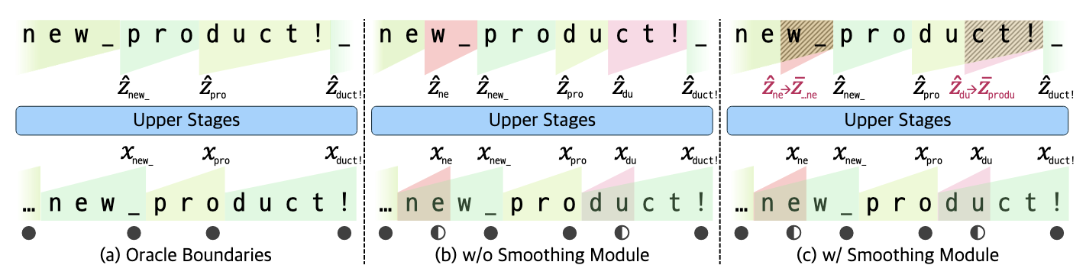
Chunking Example
Notes:
pro- – meaning forward or forth, -duct – from Latin ducere, meaning to lead or to bring
Oracle = ideal truth
B: low confidence boundaries create misalignment, pink red regions show incorrect context
C: same suboptimal chunking, but errors are corrected, low confidence chunks get interpolated with previous chunks

Slide 45
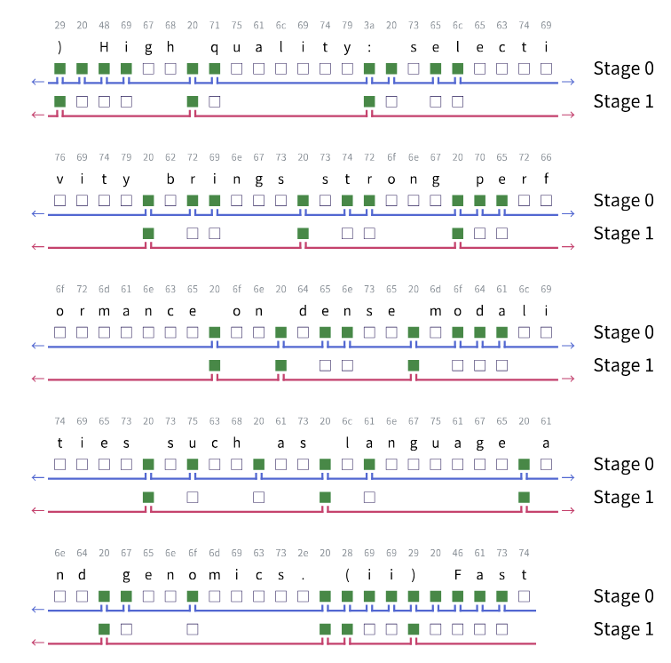
Recursion/Staging
Raw bytes → Stage 0 chunking → Stage 1 chunking → Main

Slide 46
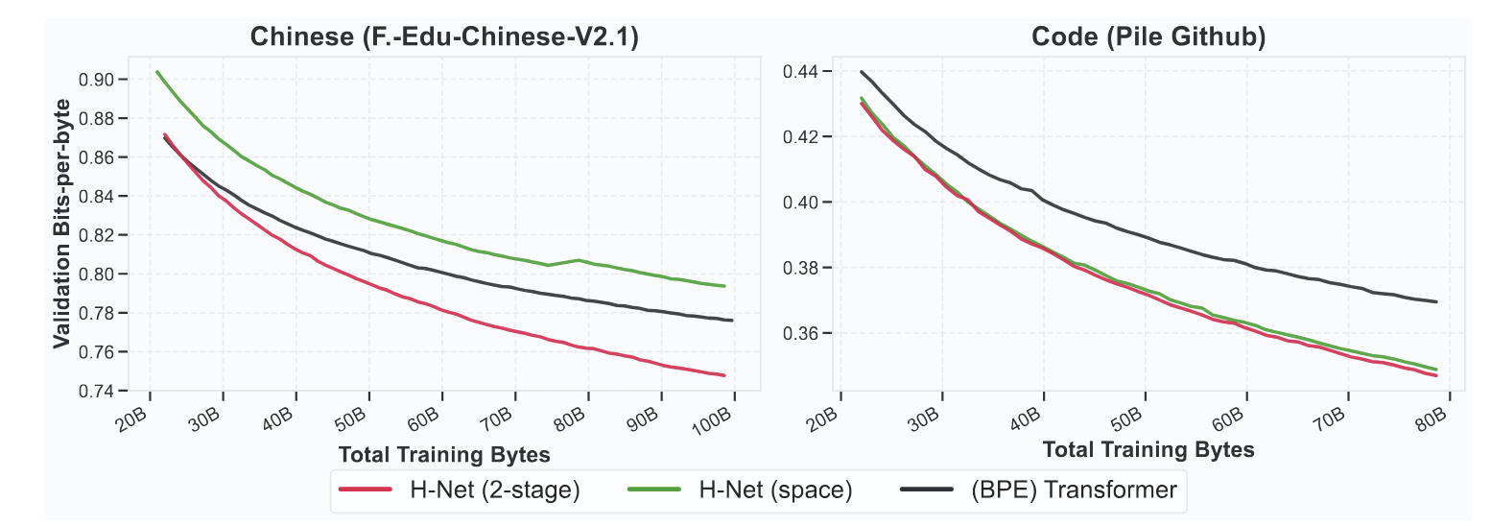
Weak Tokenization Heuristics
Notes:
Average number of bits the model assigns to predict each byte in a sequence

Slide 47
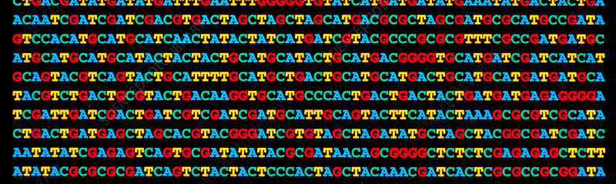
Human Genome Evaluation
No natural segmentation cues (spaces, punctuation)
Uniform, low complexity alphabet
Context-dependent function
Hierarchical structure: codons → genes → regulatory elements

Slide 48
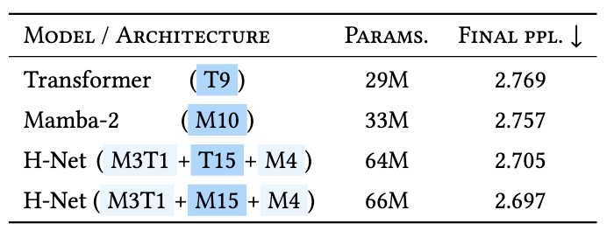
Perplexity (ppl)
“How many choices does the model think it has on average?”
Perplexity = exp(CE)
Lower ppl = better model
ppl of 4 = model is as confused as guessing among 4 options

Slide 49
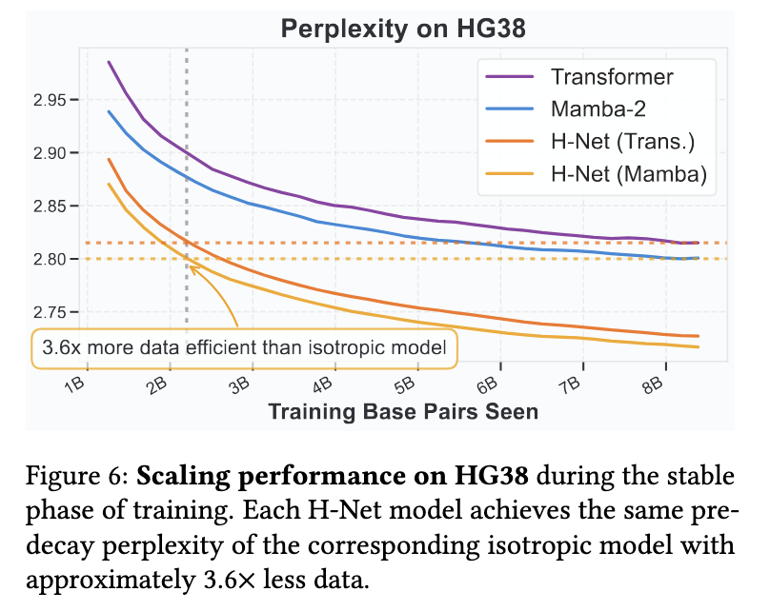

Slide 50
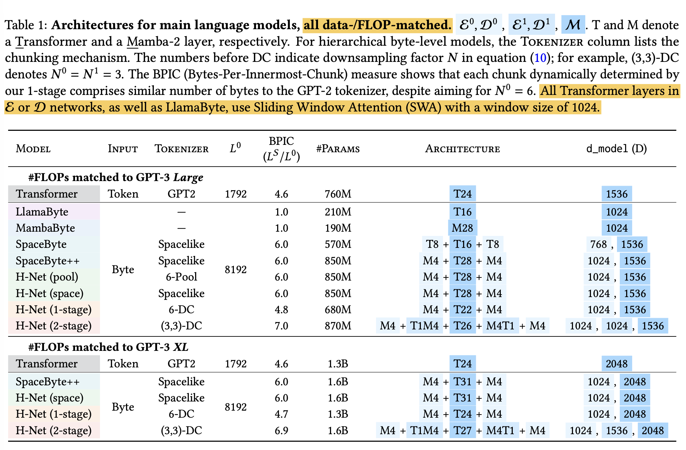
Main Evaluation
T: Transformer
M: Mamba (SSM)
BPIC: Compress. ratio
Notes:
Encoder just aggregates the chunks, decoder redistributes -> local attn is enough
More #params doesn’t lead to more compute, especially for mamba

Slide 51
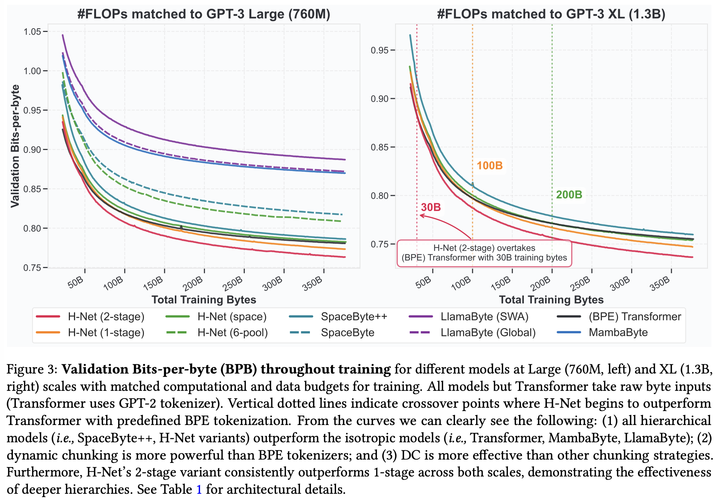
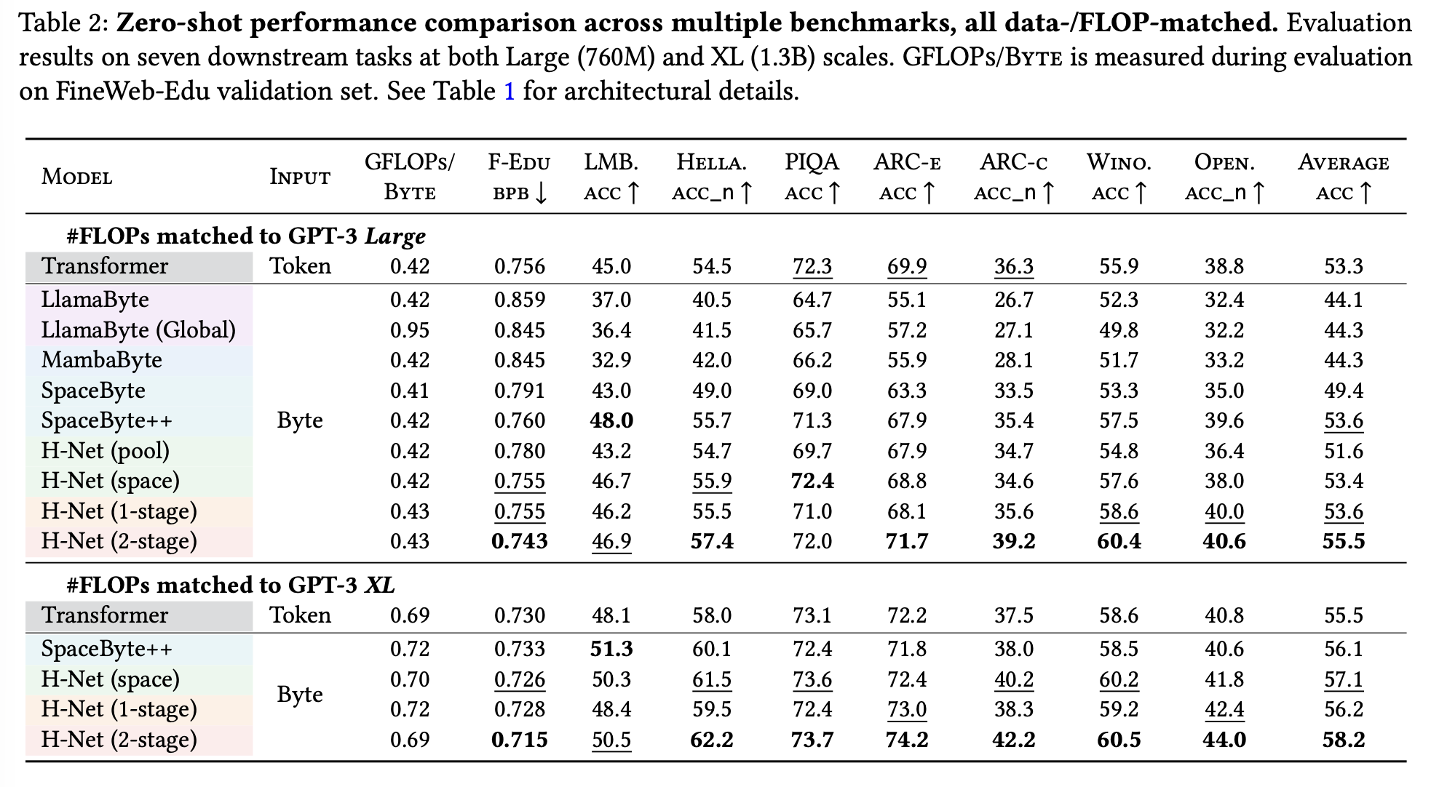
Main Evaluation
Notes:
LlamaByte (Global) is 2x compute
Even with more compute, transformer cannot catch up with mamba when directly modeling bytes.

Slide 52
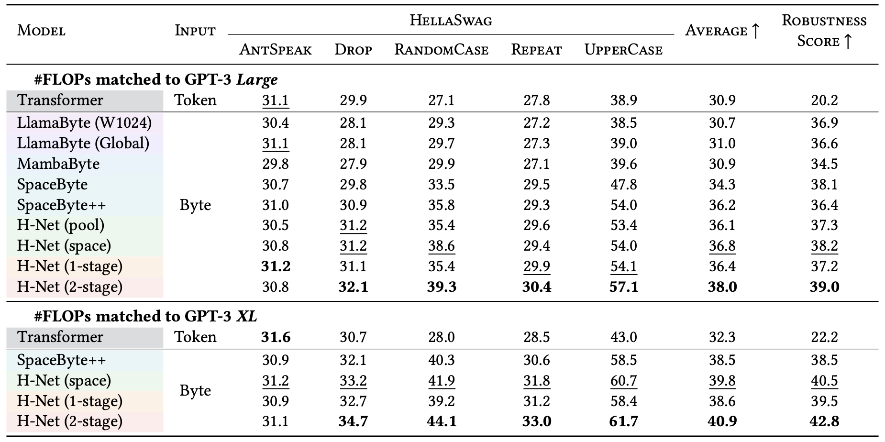
Robustness to Char-Level Noise
AntSpeak: uppercase, space-sep chars
Drop: remove 10% chars
RandomCase: convert cases randomly
Repeat: repeat 20% chars upto 4x
UpperCase: all caps

Slide 53
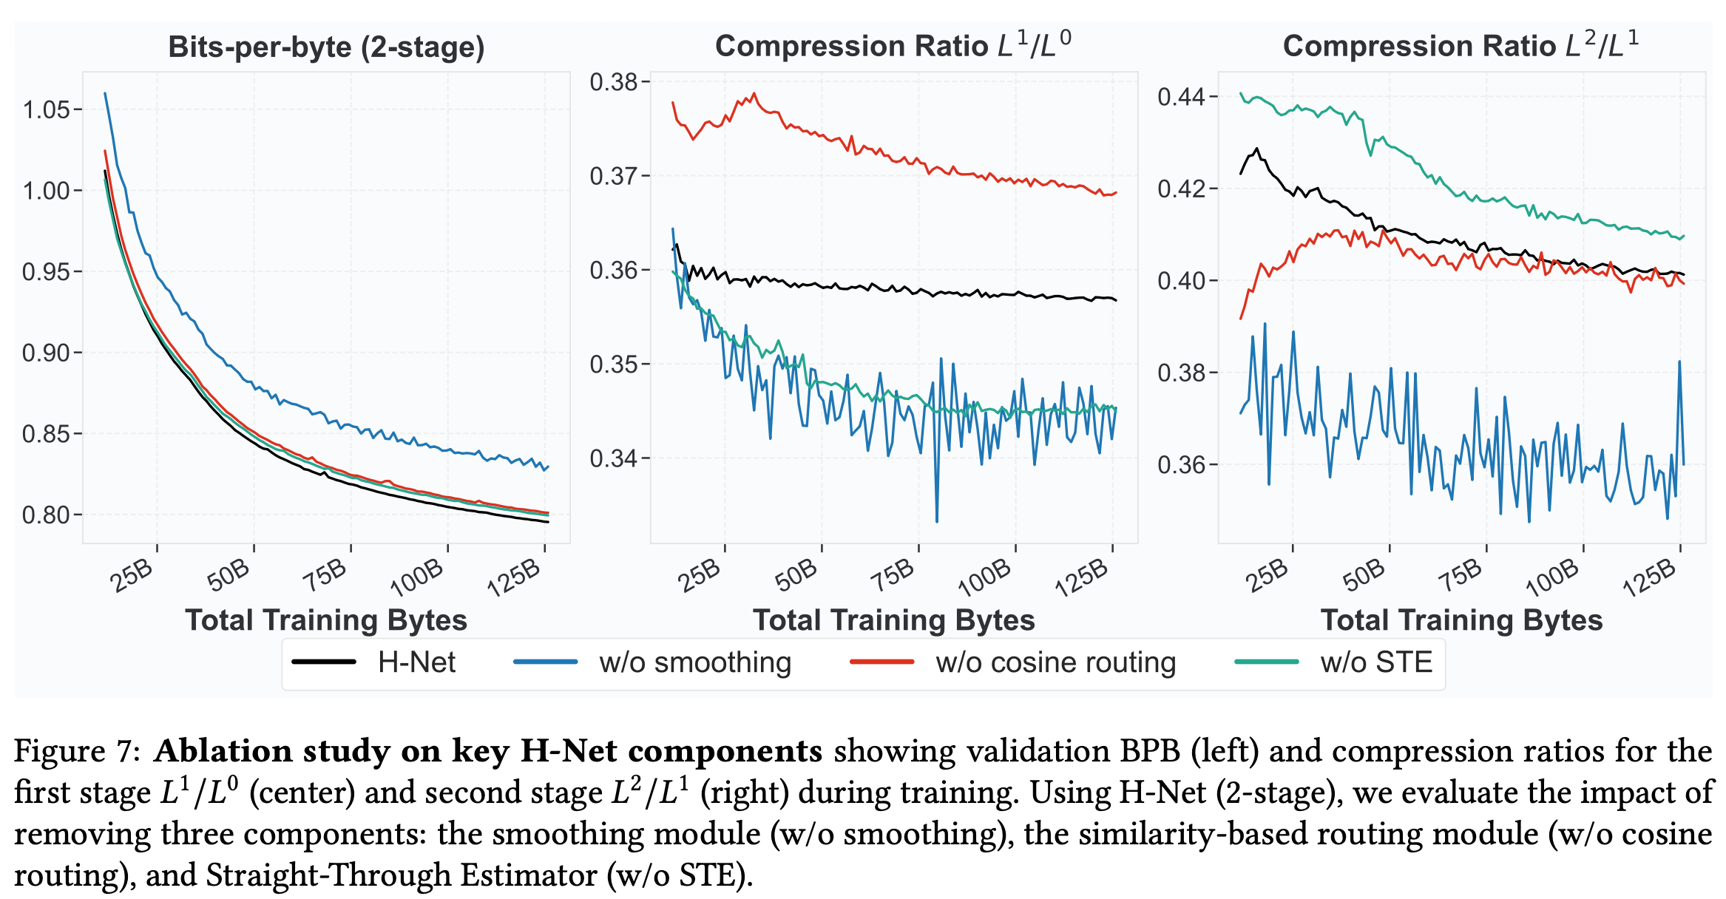
Ablation Study
STE makes each of these 1 no matter what c is
Notes:
CR targeted at one third for both stages
Cosine routing and ste doesn’t really matter. None of them help matching the target CR
Smoothing in dechuncking does matter -> give training signal to p

Slide 54
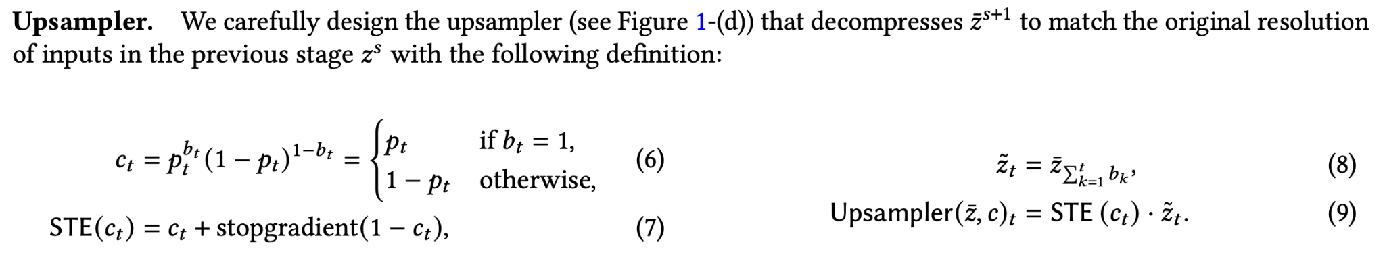
Ablation Study
STE makes each of these 1 no matter what c is
Notes:
You guys remember the network flow?
Doesn’t really make sense to me. How is eq.6 encourage F == G (p == b)?
Remember we need the equality for the ratio loss to make sense

Slide 55
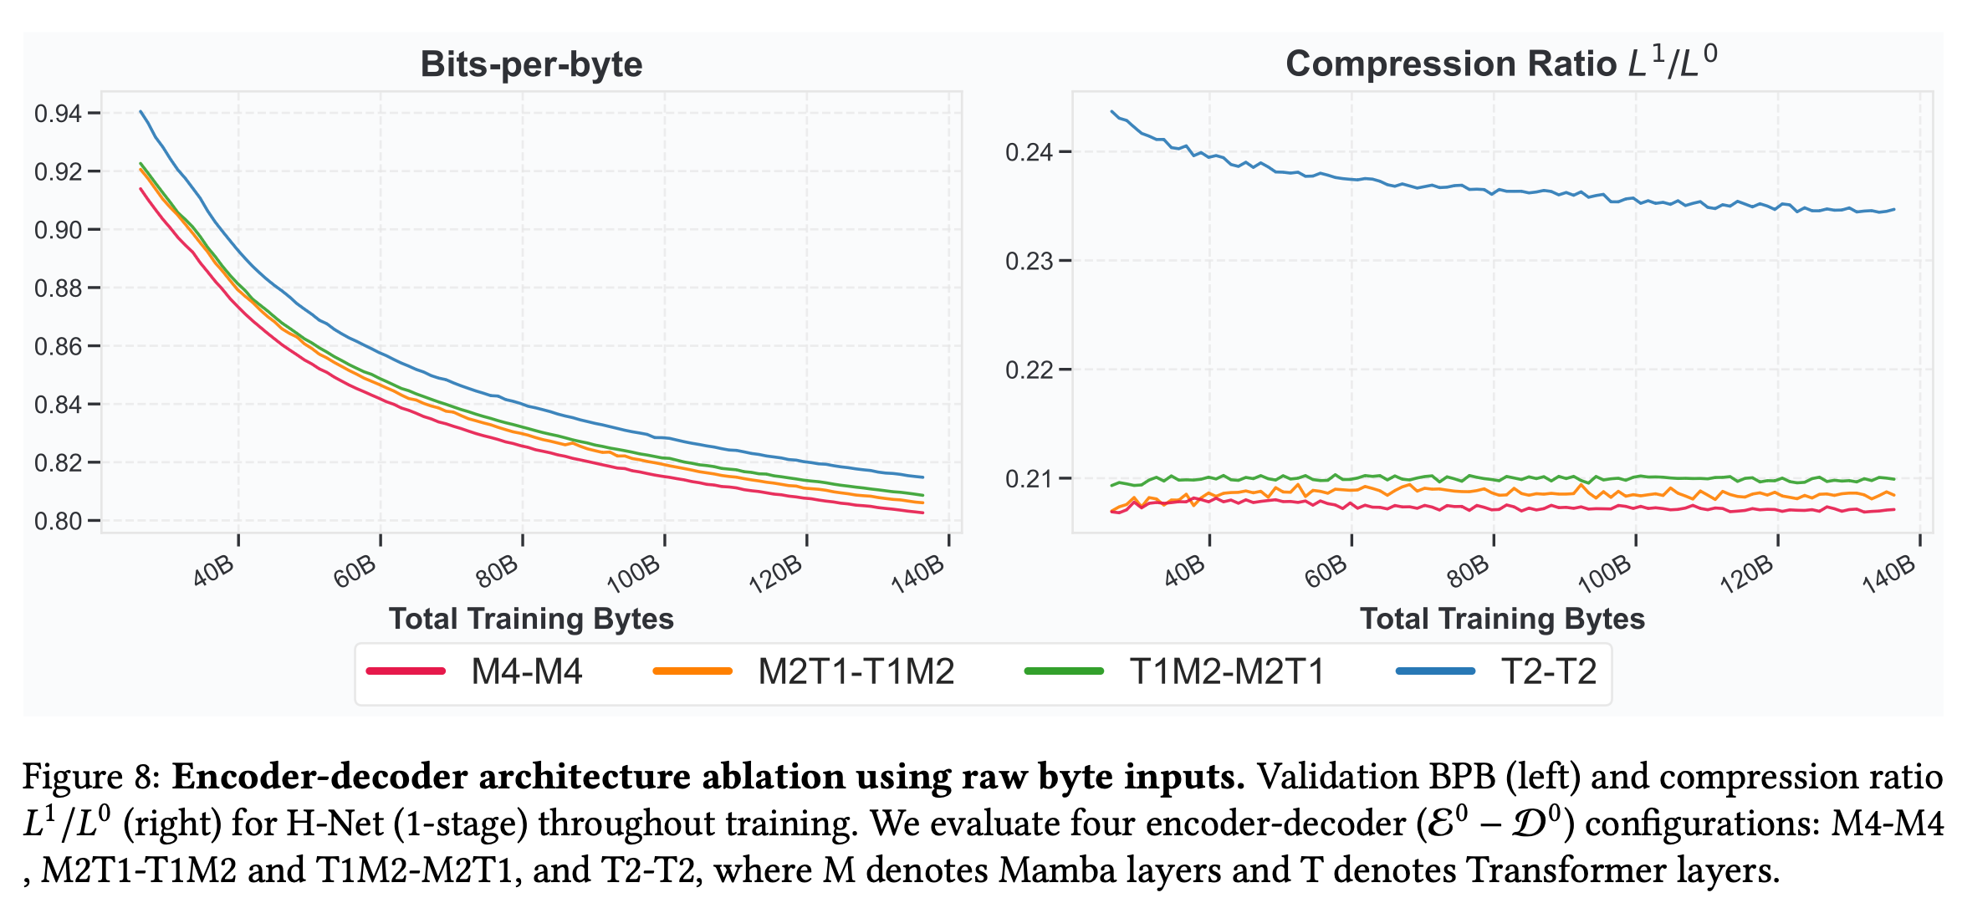
Ablation Study – Encoder-Decoder Arch
Notes:
The more you use M, the better result you get.

Slide 56
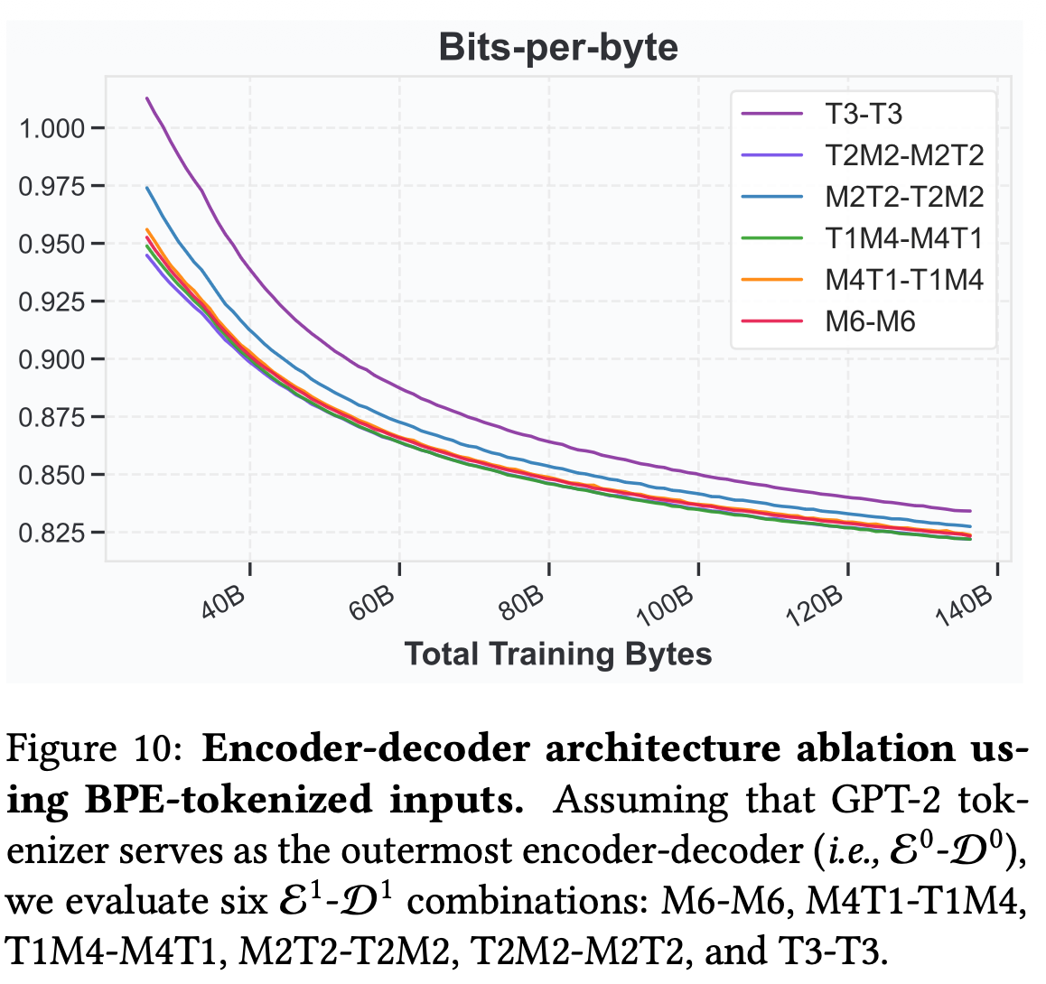
Ablation Study – Encoder-Decoder Arch
From p.19
Q: Is Mamba better because of the fine-grained byte inputs? (Fact: Mamba > Trans on bytes)
-> use BPE as stage-1 and test stage-2 arch
Notes:
Make sense to me because the semantic abstraction doesn’t need the global context, which is the strength of transformers.

Slide 57
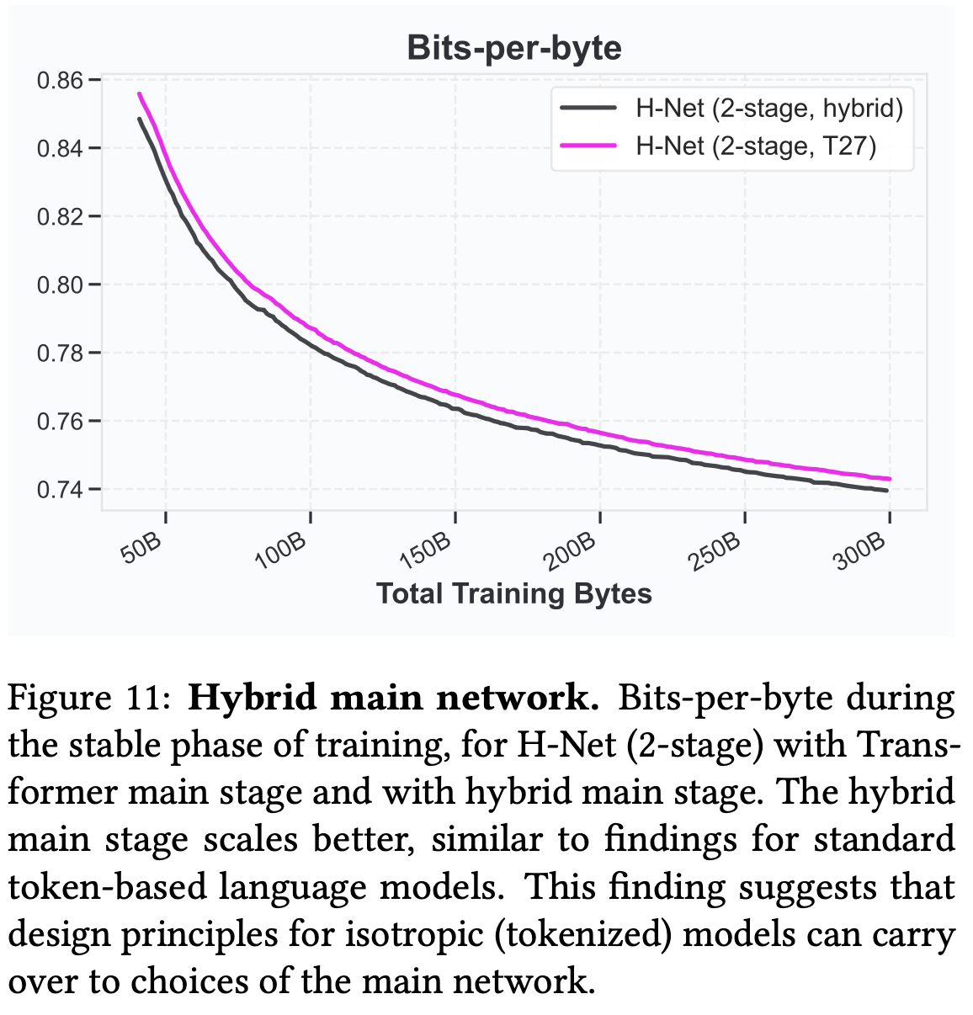
Ablation Study – Main Net Arch
Hybrid:
20 Mamba-2 and
7 Transformer layers interleaved in a 3:1 ratio.

Slide 58

Compare to MoE (Sparse Network)
Same FLOPs but more params?
-> UNFAIR!!
H-Net is by-design sparse.
-> Compare it with MoE isotropic models

Slide 59
BLT Questions (again)
Does this actually prove that tokenization is the root of all evil? Are we barking up the wrong tree in trying to keep text as the input?
Could these insights of dynamic allocation be brought to other long context tasks or other modalities?
Will these models suffer the same or worse fate as transformers in the long context regime?
Will these models scale to the 10s of billions?

Slide 60

Where On the Tokenization Spectrum Should We Sit?
Character LMs
Concept LMs

Slide 61



How much should we spend to create LM inputs?

